Slide 1
Traffic Light DFA
Tom Mackinson

Slide 2
The Problem
Simulate 2 sets of traffic lights, North/South, East/West
Possible colors
Green
Red
Yellow
Flashing Green
Flashing Yellow
Flashing Red
Basic Rules
Lights can not be same color at same time (except for red)
Flashing Lights have to become solid to change colors

Slide 3
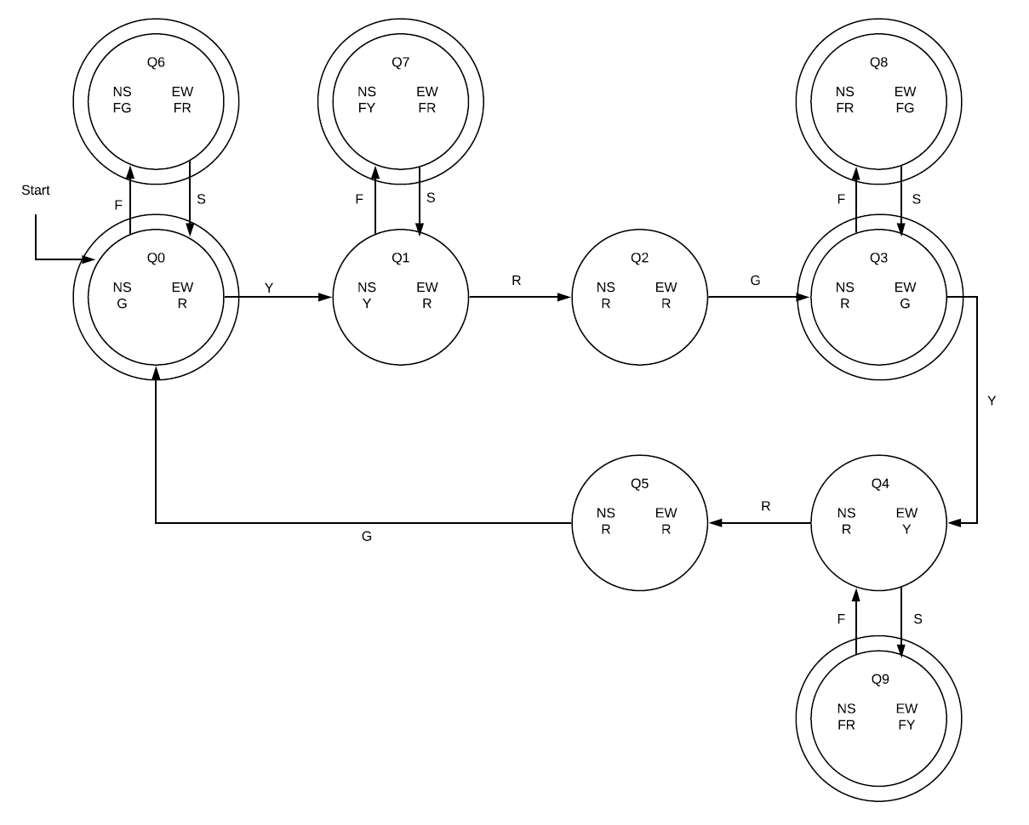
The Solution
Notes:
Test 1 - YRGYRG
Test 2 - YRGF
Test 3 - YGRRR

Slide 4
Any Questions?

